Slide 1
FOSS4GNL 2019 – QGIS voor humanitaire hulp Marijke Panis MSc Hydrology

Slide 2



510 million square kms
total surface of the earth.
We aim to help every Red Cross national society in need anywhere.
Notes:
“WE GET OUR NAME FROM THE TOTAL SURFACE AREA OF THE EARTH
WE AIM TO HELP EVERY NATIOANL SOCIEIETY IN NEED ANYWHERE”

Slide 3
Our Purpose is to improve speed, quality & cost-effectiveness of humanitarian aid
by using & creating data & digital products.
Notes:
“510’S PURPOSE IS... & MY SKILLS HELPS 510 MOVE FORWARD ON
X /Y”

Slide 4

2019
OTHER
DATA TEAMS
10
Our growth
Over the last 3 years
STUDENT
31
2018
2017
PROFESSIONAL
VOLUNTEERS
35
2016
PROJECT STAFF
13
CORE STAFF 5
Notes:
510 started in march 2016 with a core team of 3 and never stopped growing…
We are currently at circa 90 team members
I Joined in 2018 as an graduate intern and started in May this year as Hazard and Impact Analyst

Slide 5
FRONT/BACK
END
DEVELOPMENT
LAW &
POLICY
GEOGRAPHIC
INFORMATION
SYSTEMS
POLITICAL
SCIENCE
Our team skills
Are cross pollinated
ECONOMETRICS
DATA
SCIENCE
GEO
SCIENCES
DATA
ANALYSIS
HEALTH
SCIENCE
AI &
MACHINE
LEARNING
HUMAN
CENTERED
DESIGN
As part of 510 you are part of a larger network of skills
Notes:
As part of 510 you are part of a larger network of skills, My skills are in the data analyses, but I often work with data scientist, AI and Machine Learning, but also human centred design. How do you translate data into understandable and usable language in the field.

Slide 6
DISASTER
RESPONSE
We prioritise disasters… whilst working across other disaster phases too
EARLY WARNING
EARLY ACTION
DISASTER
RECOVERY
DISASTER
PREPARENDESS
DISASTER RESPONSE PHASES
Notes:
“WE PRIORITISE DISASTERS…..My work focuses on disaster phase disaster preparedness, EWEA and Disaster Response, but if I am needed to help with disaster response that is what comes first”

Slide 7
PHASES
DISASTER
RESPONSE
DISASTER
RESPONSE
DISASTER
RESPONSE
DISASTER
RESPONSE
EARLY WARNING
EARLY ACTION
DISASTER
RECOVERY
EARLY WARNING
EARLY ACTION
DISASTER
RECOVERY
EARLY WARNING
EARLY ACTION
DISASTER
RECOVERY
EARLY WARNING
EARLY ACTION
DISASTER
RECOVERY
DISASTER
PREPARENESS
DISASTER
PREPARENESS
DISASTER
PREPARENESS
DISASTER
PREPARENESS
Notes:
We simplify the disaster phases into 4 phases, there are two before ,
Disaster preparedness, early warning early action
And one during disaster response
And one after disaster recovery.
QGIS is used in all disaster phases,

Slide 8












PHASES, CATEGORIES
DISASTER
RESPONSE
DISASTER
RESPONSE
DISASTER
RESPONSE
DISASTER
RESPONSE
EARLY WARNING
EARLY ACTION
DISASTER
RECOVERY
EARLY WARNING
EARLY ACTION
DISASTER
RECOVERY
EARLY WARNING
EARLY ACTION
DISASTER
RECOVERY
EARLY WARNING
EARLY ACTION
DISASTER
RECOVERY
DISASTER
PREPARENESS
DISASTER
PREPARENESS
DISASTER
PREPARENESS
DISASTER
PREPARENESS
DIGITAL
RISK
ASSESSMENT
PREDICTIVE
IMPACT
ANALYTICS
EMERGENCY
DATA
SUPPORT
DIRECT
DIGITAL
AID
Notes:
We have 4 categories at 510, especially in the predictive impact analytics and emergency data support we work with GIS. In this presentation a couple of examples will be discussed from our work within early warning, early action to disaster response.

Slide 9
PHASES, CATEGORIES & PRODUCTS
DISASTER
RESPONSE
DISASTER
RESPONSE
DISASTER
RESPONSE
DISASTER
RESPONSE
EARLY WARNING
EARLY ACTION
DISASTER
RECOVERY
EARLY WARNING
EARLY ACTION
DISASTER
RECOVERY
EARLY WARNING
EARLY ACTION
DISASTER
RECOVERY
EARLY WARNING
EARLY ACTION
DISASTER
RECOVERY
DISASTER
PREPARENESS
DISASTER
PREPARENESS
DISASTER
PREPARENESS
DISASTER
PREPARENESS
DIGITAL
RISK
ASSESSMENT
PREDICTIVE
IMPACT
ANALYTICS
EMERGENCY
DATA
SUPPORT
DIRECT
DIGITAL
AID
CRA COMMUNITY RISK ASSESSMENT
ERA EPIDEMIC RISK ASSESSMENT
LANDSCAPE RESTAORATION
IBF IMPACT BASED FORECAST
IMPACT ASSESSMENT TOOLS
POPULATION MOVEMENT TOOLS
SIMS SURGE INFORMATION MANAGEMENT
BILATERAL SUPPORT ( NOT SIMS)
DAMAGE ASSESSMENT TOOLS
POPULATION MOVEMENT TOOLS
121 CASH BASED AID
Notes:
These 4 categories contain both data & digital products as you can see named below.
I primarily work on … ( select the product you work on)
I work on a component that is used for ( name the product using your work)
I work on all these by focusing on Data responsibility, Human Centered design, Digital transformation

Slide 10
DISASTER
RESPONSE
DISASTER PHASES & GIS
EARLY WARNING
EARLY ACTION
DISASTER
RECOVERY
DISASTER
PREPARENESS
510
510 CATEGORIES & PRODUCTs
WHEN DO WE USE GIS?
WHAT EXAMPLES DO WE HAVE & WHERE WE USE IT?
WHY DO WE NEED GIS FOR HUMANITARIAN AID?
WHO WORKS ON GIS WITHIN 510?
Notes:
”SO YOU KNOW A LITTLE ABOUT 510 AND ITS CATEGORIES AND PRODUCTS BUT IN THE REST OF THIS PRESENTATION YOU WILL UNDERSTAND
WHAT WE DO, WHY WE DO IT, HOW WE DO IT AND WHERE WHEN AND WITH WHO WE DO IT, MY GOAL IS FOR YOU AS AN AUDIENCE TO UNDERSTAND WHERE MY WORK FITS INTO 510’S PURPOSE!”

Slide 11
WHEN DO WE USE GIS?
DISASTER
RESPONSE
DISASTER
RESPONSE
DISASTER
RESPONSE
DISASTER
RESPONSE
EARLY WARNING
EARLY ACTION
DISASTER
RECOVERY
EARLY WARNING
EARLY ACTION
DISASTER
RECOVERY
EARLY WARNING
EARLY ACTION
DISASTER
RECOVERY
EARLY WARNING
EARLY ACTION
DISASTER
RECOVERY
DISASTER
PREPARENESS
DISASTER
PREPARENESS
DISASTER
PREPARENESS
DISASTER
PREPARENESS
Notes:
We simplify the disaster phases into 4 phases, there are two before ,
Disaster preparedness, early warning early action
And one during disaster response
And one after disaster recovery.
QGIS is used in all disaster phases,

Slide 12
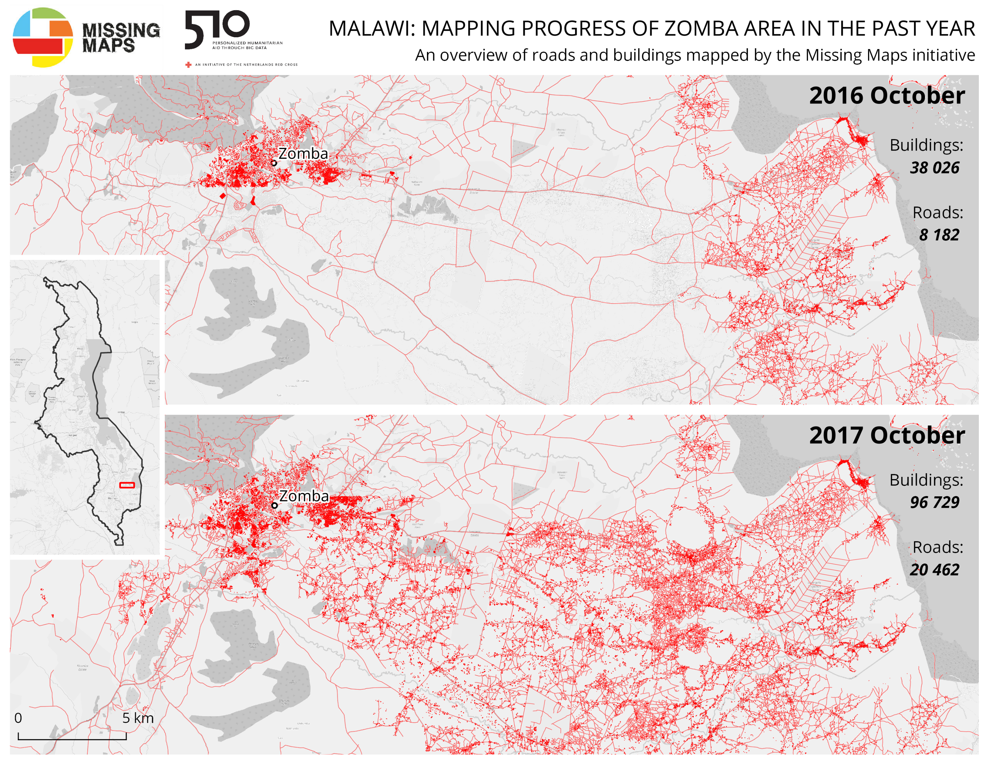
PHASE: DISASTER PREPAREDNESS
DISASTER
RESPONSE
EARLY WARNING
EARLY ACTION
DISASTER
RECOVERY
DISASTER
PREPARENESS
GIS &
COMMUNITY RISK ASSESSMENT
Notes:
These 4 categories contain both data & digital products as you can see named below.
I primarily work on … ( select the product you work on)
I work on a component that is used for ( name the product using your work)
I work on all these by focusing on Data responsibility, Human Centered design, Digital transformation

Slide 13


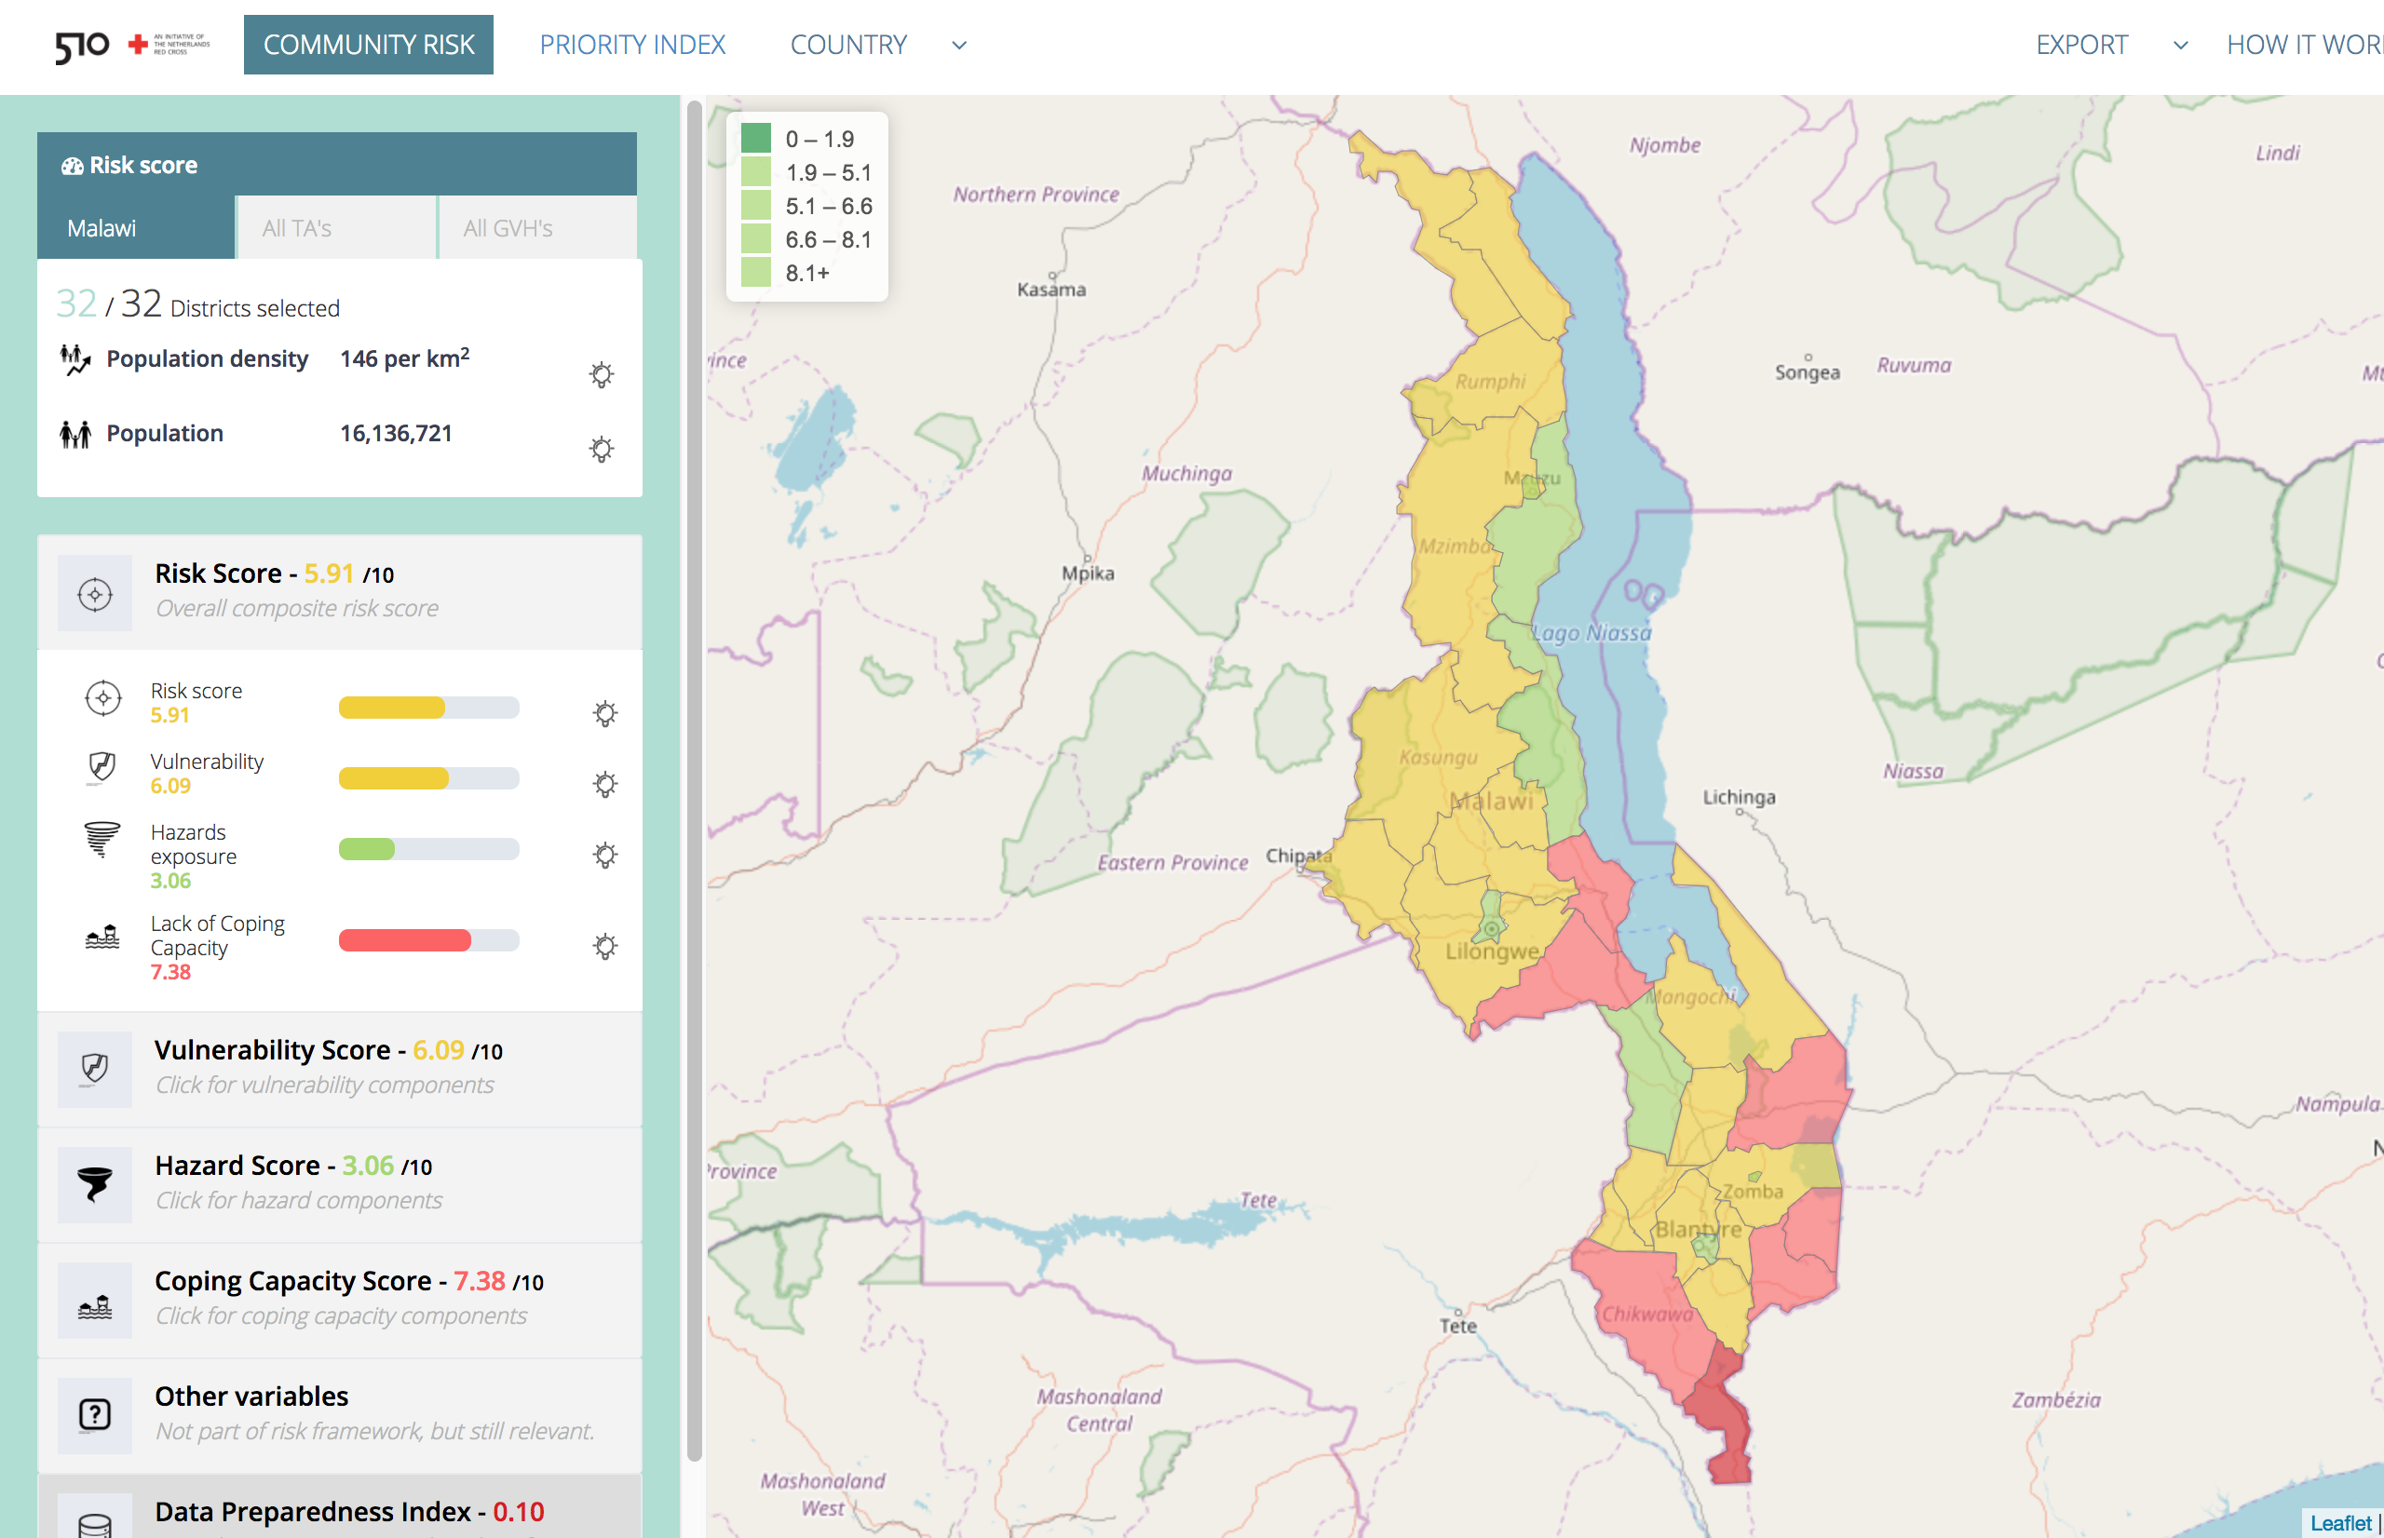
COMMUNITY RISK ASSESMENT
1: Understanding risk
DEVELOP RISK MODELS
OVERVIEW OF VULNERABLE AREAS
COMMUNITY RISK ASSESSMENT
POPULATION DATA
COMMUNITY RISK ASSESSMENT DASHBOARD
DISASTER
RESPONSE
EARLY WARNING
EARLY ACTION
DISASTER
RECOVERY
DISASTER
PREPARENESS
Notes:
IBF has three component, the first is
In essence we create an interactive map.

Slide 14
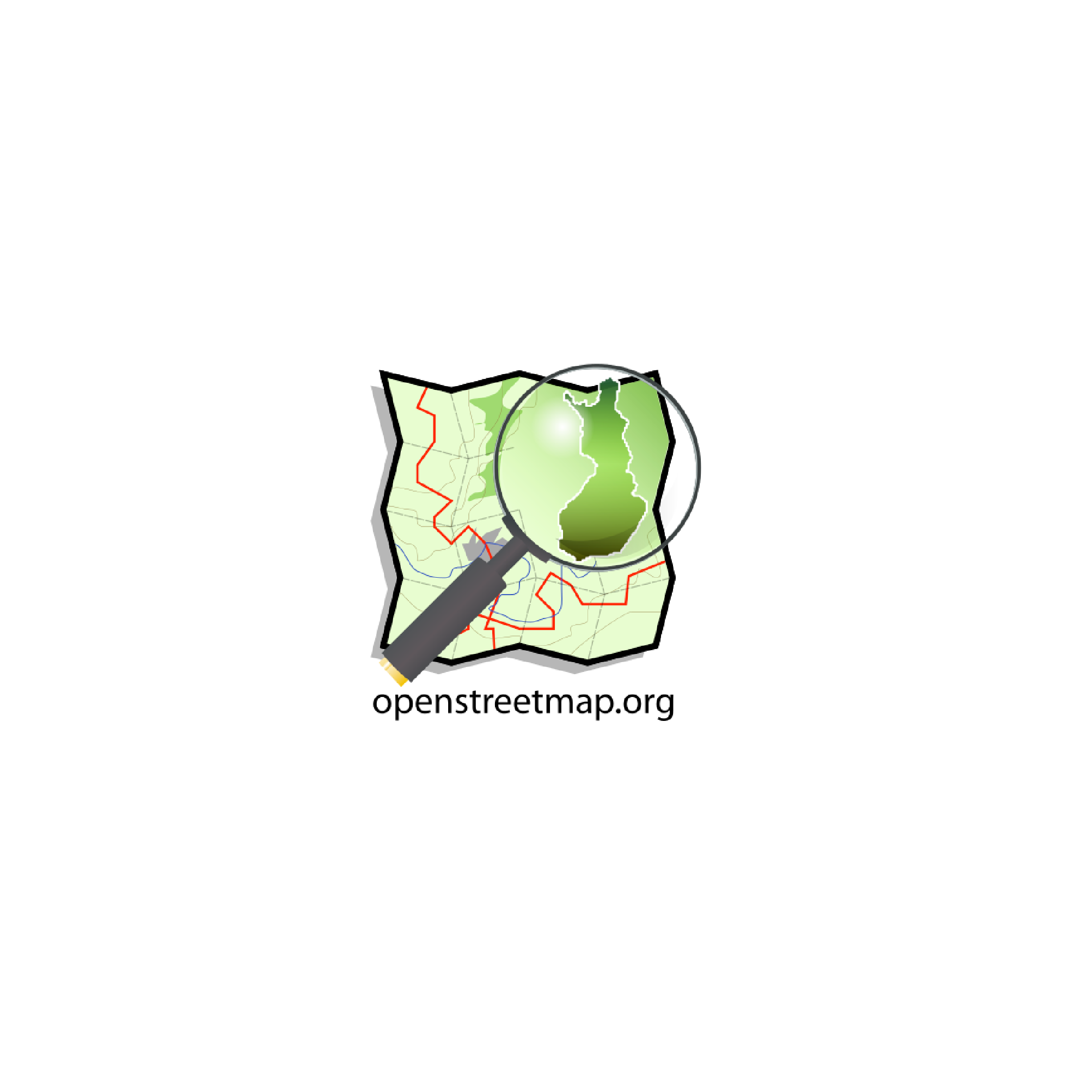




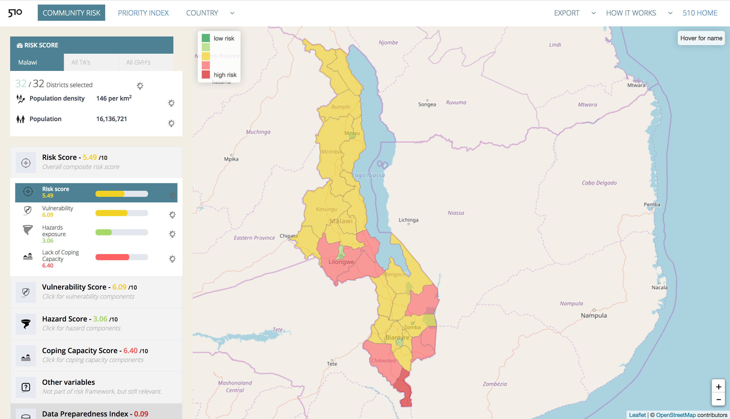
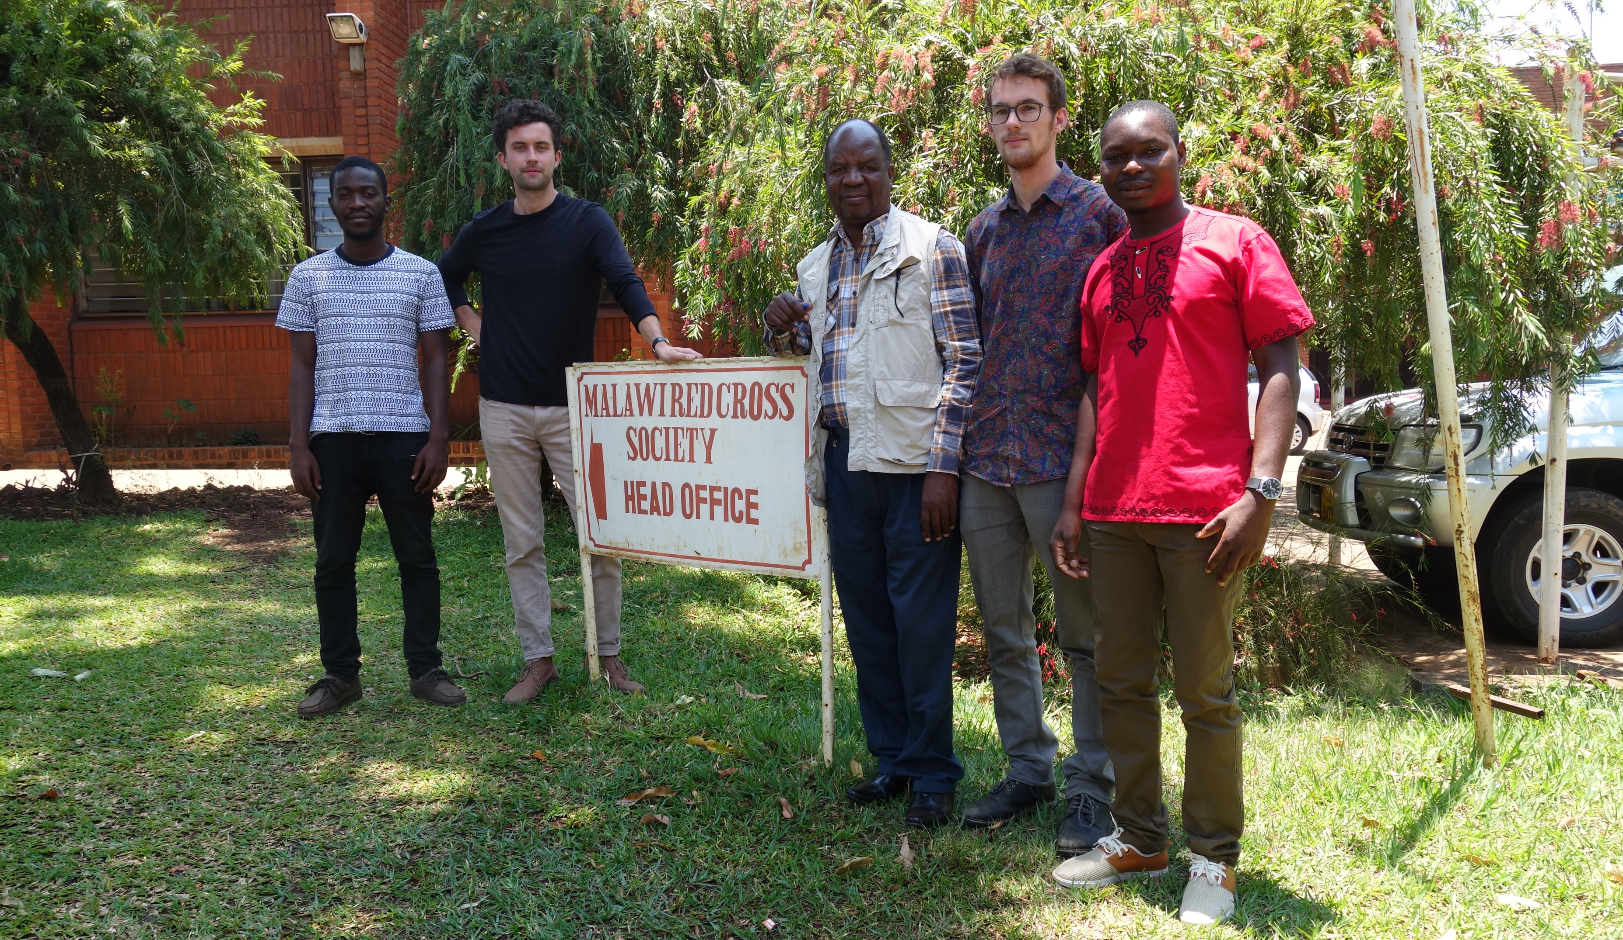


PHASE: DISASTER PREPAREDNESS
Notes:
FOR OUR DASHBOARD WE USE OPEN STREET MAP AS A BASE
ANY INFORMATION WE ARE MISSING FOR CERTAIN AREAS
WE GATHER BY CREATING HOTOSM TASKS
AND FILL IT IN BY USING THE MISSING MAPS INITIATIVE
WE ALSO WORK TOGETHER WITH THE MALAWIAN RED CROSS DATA TEAM THAT WE TRAINED IN 2017

Slide 15
PHASE: DISASTER PREPAREDNESS

Slide 16
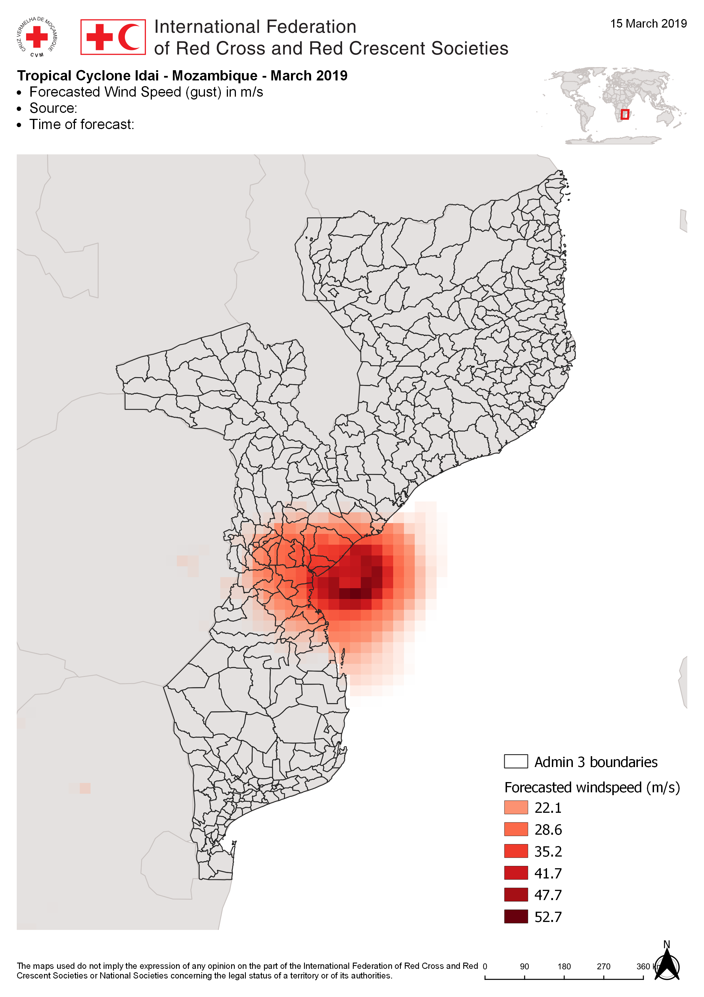
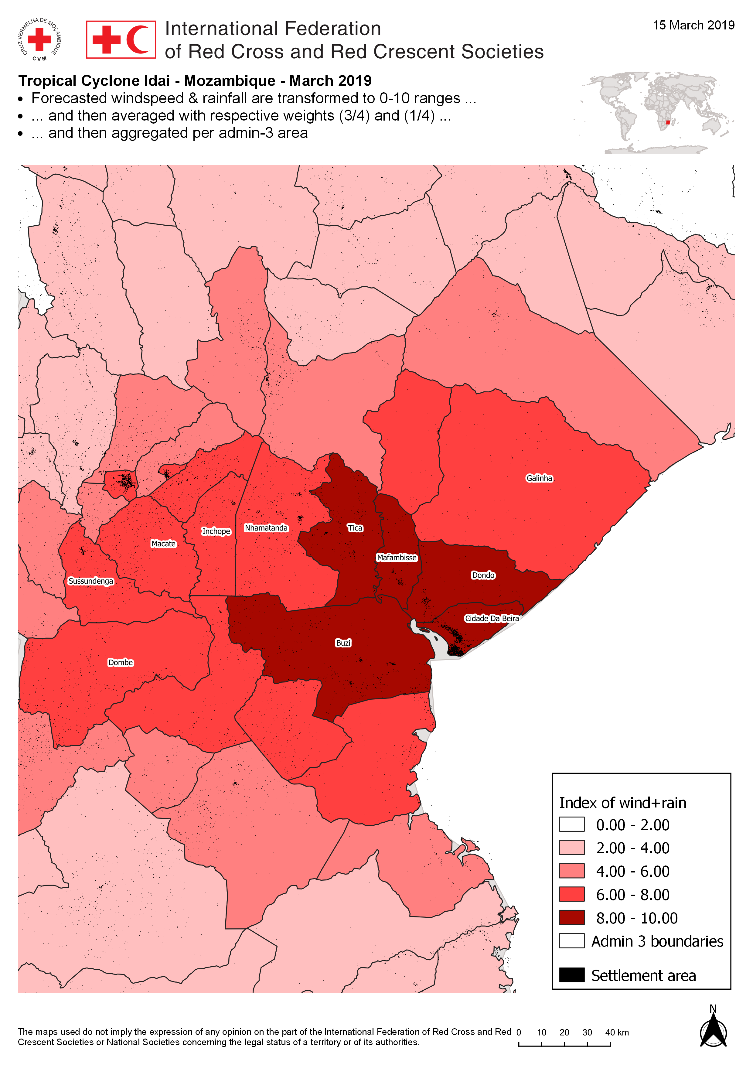
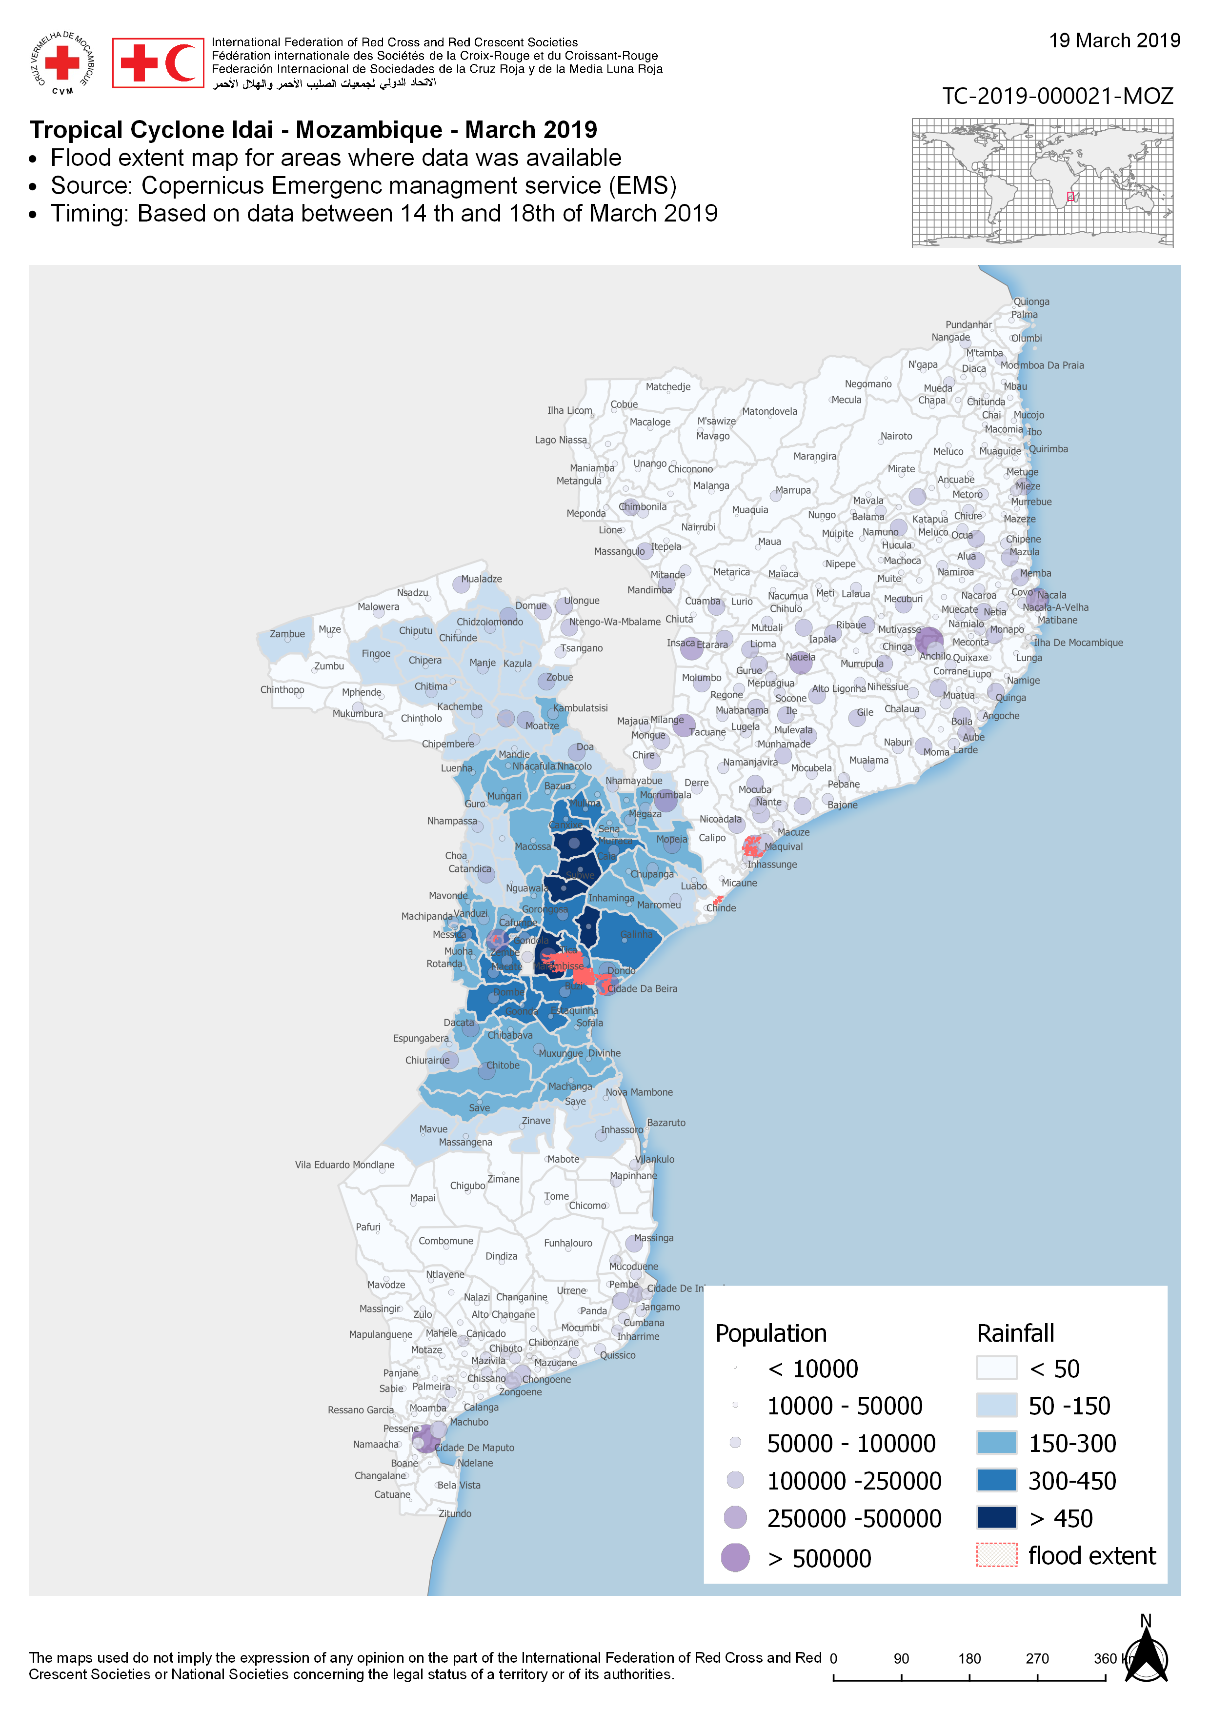
PHASES: EARLY WARNING EARLY ACTION
DISASTER
RESPONSE
DISASTER
RESPONSE
EARLY WARNING
EARLY ACTION
DISASTER
RECOVERY
EARLY WARNING
EARLY ACTION
DISASTER
RECOVERY
DISASTER
PREPARENESS
DISASTER
PREPARENESS
GIS &
COMMUNITY RISK ASSESSMENT
GIS &
IMPACT BASED FORECAST
Notes:
Historical flood extent maps
What does it mean for GIS?

Slide 17



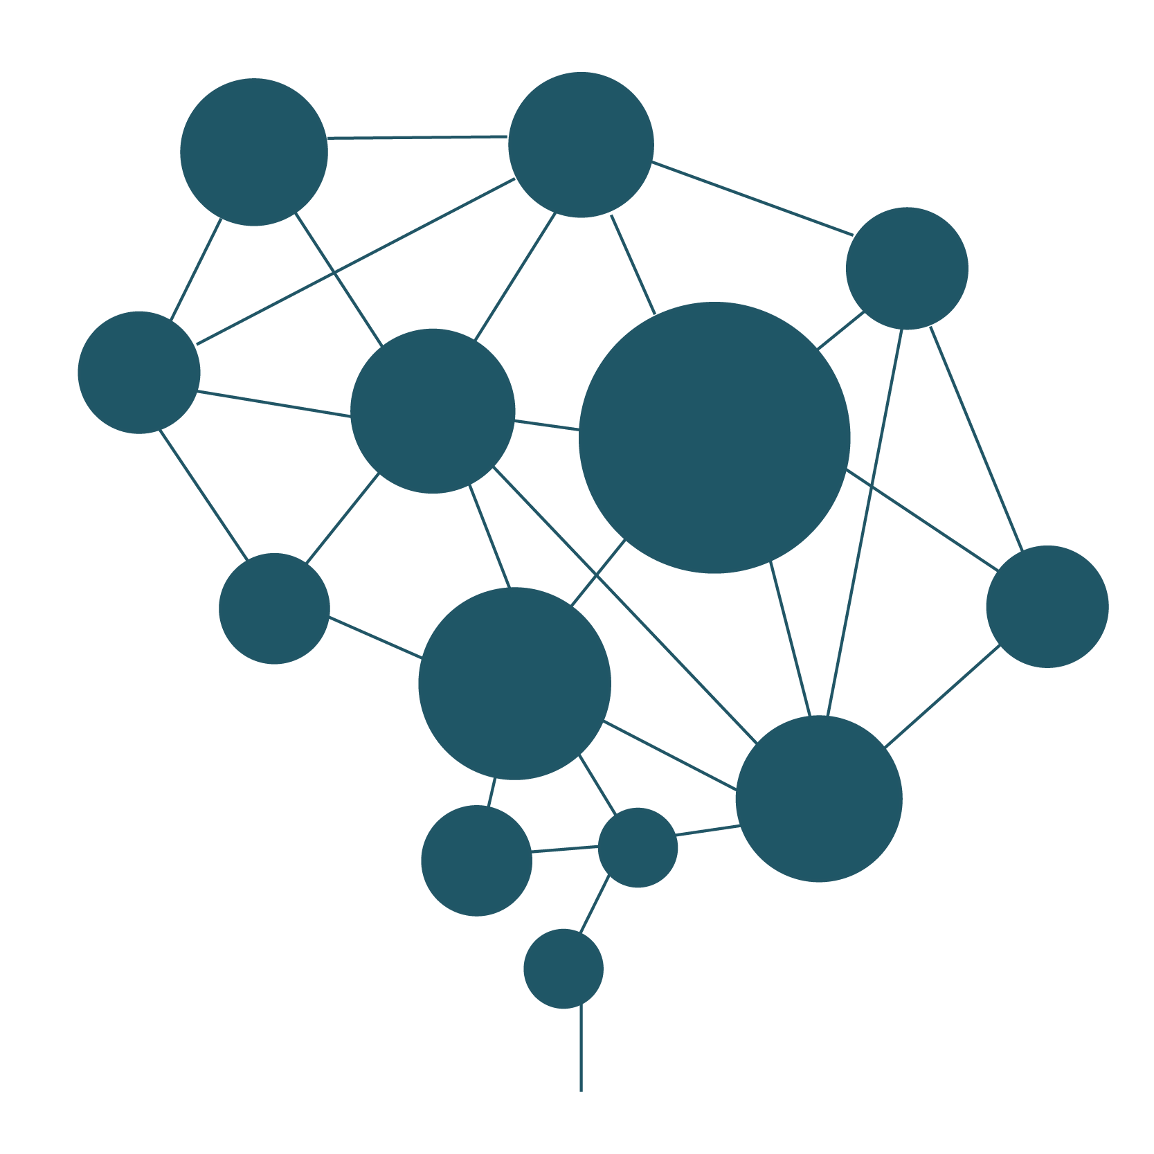
IMPACT BASED FORECASTING
1: Understanding risk
DEVELOP RISK MODELS
OVERVIEW OF VULNERABLE AREAS
COMMUNITY RISK ASSESSMENT
POPULATION DATA
COMMUNITY RISK ASSESSMENT DASHBOARD
DISASTER
RESPONSE
2: Identify impact
EARLY WARNING
EARLY ACTION
DISASTER
RECOVERY
Historical events data
Analysis & insights
MACHINE LEARNING
Impact on population
Identify trigger levels
DATA ANALYSES
DISASTER
PREPARENESS
DISASTER
RESPONSE
MACHINE LEARNING
EARLY WARNING
EARLY ACTION
DISASTER
RECOVERY
DISASTER
PREPARENESS
Notes:
Historical flood extent maps
What does it mean for GIS?

Slide 18
PHASES: EARLY WARNING EARLY ACTION
Notes:
Another example is the current Mozambique cycloon, where we used QGISE as tool to convert data into understanding.

Slide 19
PHASES: EARLY WARNING EARLY ACTION
Notes:
Another example is the current Mozambique cycloon, where we used QGISE as tool to convert data into understanding.

Slide 20
PHASES: EARLY WARNING EARLY ACTION
Notes:
Another example is the current Mozambique cycloon, where we used QGISE as tool to convert data into understanding.

Slide 21
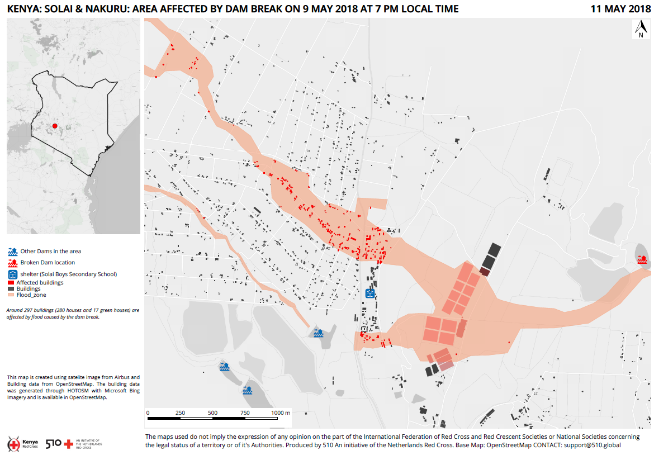
PHASE: DISASTER RESPONSE
DISASTER
RESPONSE
DISASTER
RESPONSE
DISASTER
RESPONSE
EARLY WARNING
EARLY ACTION
DISASTER
RECOVERY
EARLY WARNING
EARLY ACTION
DISASTER
RECOVERY
EARLY WARNING
EARLY ACTION
DISASTER
RECOVERY
DISASTER
PREPARENESS
DISASTER
PREPARENESS
DISASTER
PREPARENESS
GIS &
COMMUNITY RISK ASSESSMENT
GIS &
IMPACT BASED FORECAST
GIS &
SURGE INFORMATION MANAGEMENT

Slide 22
PHASE: DISASTER RESPONSE
DISASTER
RESPONSE
EARLY WARNING
EARLY ACTION
DISASTER
RECOVERY
DISASTER
PREPARENESS

Slide 23
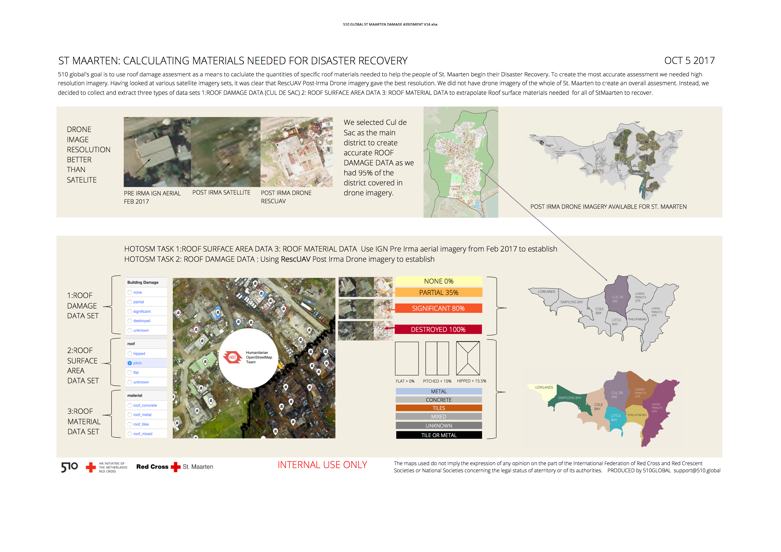
DISASTER
RESPONSE
PHASE: DISASTER RECOVERY
EARLY WARNING
EARLY ACTION
DISASTER
RECOVERY
DISASTER
PREPARENESS
DISASTER
RESPONSE
DISASTER
RESPONSE
DISASTER
RESPONSE
DISASTER
RESPONSE
EARLY WARNING
EARLY ACTION
DISASTER
RECOVERY
EARLY WARNING
EARLY ACTION
DISASTER
RECOVERY
EARLY WARNING
EARLY ACTION
DISASTER
RECOVERY
EARLY WARNING
EARLY ACTION
DISASTER
RECOVERY
DISASTER
PREPARENESS
DISASTER
PREPARENESS
DISASTER
PREPARENESS
DISASTER
PREPARENESS
GIS &
COMMUNITY RISK ASSESSMENT
GIS &
IMPACT BASED FORECAST
GIS &
SURGE INFORMATION MANAGEMENT
GIS &
DAMMAGE ASSESSMENT
Notes:
These 4 categories contain both data & digital products as you can see named below.
I primarily work on … ( select the product you work on)
I work on a component that is used for ( name the product using your work)
I work on all these by focusing on Data responsibility, Human Centered design, Digital transformation

Slide 24

Notes:
Link from early warning to emergency data support

Slide 25
PHASE: DISASTER RECOVERY
DISASTER
RESPONSE
PHASE: DISASTER RECOVERY
EARLY WARNING
EARLY ACTION
DISASTER
RECOVERY
DISASTER
PREPARENESS
DISASTER
RESPONSE
EARLY WARNING
EARLY ACTION
DISASTER
RECOVERY
DISASTER
PREPARENESS

Slide 26
WHY DO WE NEED GIS?
DISASTER
RESPONSE
DISASTER
RESPONSE
DISASTER
RESPONSE
DISASTER
RESPONSE
EARLY WARNING
EARLY ACTION
DISASTER
RECOVERY
EARLY WARNING
EARLY ACTION
DISASTER
RECOVERY
EARLY WARNING
EARLY ACTION
DISASTER
RECOVERY
EARLY WARNING
EARLY ACTION
DISASTER
RECOVERY
DISASTER
PREPARENESS
DISASTER
PREPARENESS
DISASTER
PREPARENESS
DISASTER
PREPARENESS
GIS &
COMMUNITY RISK ASSESSMENT
GIS &
IMPACT BASED FORECAST
GIS &
SURGE INFORMATION MANAGEMENT
GIS &
DAMMAGE ASSESSMENT
Notes:
These 4 categories contain both data & digital products as you can see named below.
I primarily work on … ( select the product you work on)
I work on a component that is used for ( name the product using your work)
I work on all these by focusing on Data responsibility, Human Centered design, Digital transformation

Slide 27
Our mission is to shape the future of humanitarian aid by converting data into understanding, and put it in the hands of humanitarian aid workers, decision makers & people affected, so that they can better prepare for and cope with disasters and crises.
Notes:
“510’S PURPOSE IS... & MY SKILLS HELPS 510 MOVE FORWARD ON
X /Y”

Slide 28
GIS is an integral part of converting data into understanding!
Do you want to volunteer? support@510.global
Notes:
“510’S PURPOSE IS... & MY SKILLS HELPS 510 MOVE FORWARD ON
X /Y”

Slide 29
FOSS4GNL 2019 – QGIS voor humanitaire hulp Marijke Panis support@510.global mpanis@redcross.nl

